Slide 1
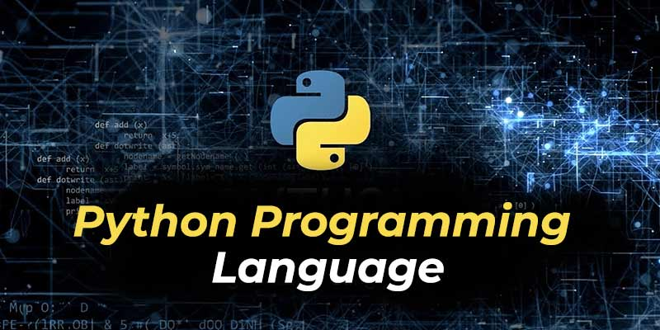

Slide 2
Learning Objectives
In this chapter, you will learn:
Understand what Python is and why it is widely used.
Learn about Python’s key features, benefits, and applications in various industries.
Explore career opportunities and job market demand for Python developers.
Learn about Python's ecosystem, including open-source libraries.
Install Python and Jupyter Notebook and run a simple print() statement.

Slide 3
Introducing to Python
Python is a high-level programming language used for general-purpose software engineering
Server-side language:
Handles logic processing, user inputs, databases, and server interactions
Developed by Guido Van Rossum in the late 1980s
Modeled after the English language to make it easy to read and write
Popularity has grown due to its use in data science
Notes:
Python is an open-source programming language that allows you to run applications and plugins from a wide variety of 3rd party sources (or even applications you develop yourself) on your server. Python is cross-platform, meaning that you can run it on a number of different operating systems, including Windows, Linux, VPS Server, and Apple.

Slide 4
Python Characteristics
Open-source language
Simple, with straightforward syntax
Strong community in Machine Learning, Data Analysis, and AI
Allows programming without boilerplate (prepared) code
Notes:
x = 10 # No need to specify int

Slide 5
import java.util.ArrayList;
public class Main {
public static void main(String[] args) {
ArrayList<Integer> numbers = new ArrayList<>();
numbers.add(1);
numbers.add(2);
numbers.add(3);
numbers.add(4);
numbers.add(5);
ArrayList<Integer> evens = new ArrayList<>(); // List to store even numbers
for (int num : numbers) {
if (num % 2 == 0) {
evens.add(num);
}
}
System.out.println(evens); // Output: [2, 4]
}
}
numbers = [1, 2, 3, 4, 5]
evens = [num for num in numbers if num % 2 == 0]
print(evens) # Output: [2, 4]
Notes:
x = 10 # No need to specify int

Slide 6
Fun Fact
Python is named after the British comedy group Monty Python

Slide 7
Python Benefits and Growth
Versatility
Used in Data Mining, Data Science, AI, Machine Learning, Web Development, Web Frameworks, Embedded Systems, Graphic Design applications, Gaming, Network development, Product development, Rapid Application Development, Testing, Automation Scripting, etc.
Easier alternative to languages like C, R, and Java
Growing as the primary language for many applications
Fastest Growing Programming Language
High growth due to its use in data science, machine learning and AI

Slide 8
High Job Demand and High Salaries
Ranked #1 in most in-demand programming languages
Great Money for Developers
Python developers, especially in data science and web development, earn high salaries.

Slide 9
Ease of Learning & Strong Community
Easy to Read, Write, and Learn
Built to eliminate complexity, making it easy for beginners
Supportive Community
Programmers benefit from online forums, meet-ups, and the open-source community

Slide 10
Open Source Packages
Python Package Index (PyPI) library offers packages for AI, web development, and more
Users can build and contribute to the vast library
Notes:
Open source packages
Python offers a rich ecosystem of packages held within The Python Package Index (PyPI).
With Python, users can build modules for the ever-growing PyPi library.
Users of this giant third party package library can find tools to help them with projects ranging from AI to web development and more.

Slide 11
Installation
Installation Guideline G0234 2025/02: Tutorial 1 Install Python | XMUM Moodle
Download Python | Python.org

Slide 12
Running Python Code in Jupyter Notebook
In Jupyter Notebook, Python code is executed in individual cells.
Instead of running scripts through the command line, write and execute code inside a code cell.
Steps to run Python code in Jupyter Notebook:
Open Jupyter Notebook and click on New → Python 3 (.ipynb file)
Create a new cell and write your Python code.
Press Shift + Enter or click the Run button to execute the cell.

Slide 13
Running Python Code in Jupyter Notebook
print(“Welcome to Python!”)

Slide 14
Exercise: Your First Python Code
Task:
Assign a variable to store the name of the programming language you are learning
Print a message using this variable
Example: (Fill in the missing part!)
language = _____ # Assign the programming language
print("I am learning", ______)

Slide 15
Conclusion
Python is versatile, easy to learn, and has a bright future in data science and machine learning

Slide 16
Exercise: Exploring Python
Q1: Explain in your own words why Python is a popular programming language.
Q2: List three key features of Python and provide a short explanation for each.
Q3: What are some real-world applications of Python? Name at least three industries where Python is used.
Q4: Who developed Python, and when was it created?
Q5: What makes Python easier to learn compared to other programming languages like Java or C++?

Slide 17
Exercise: Exploring Python
Q1: Explain in your own words why Python is a popular programming language.
Q2: List three key features of Python and provide a short explanation for each.
Q3: What are some real-world applications of Python? Name at least three industries where Python is used.
Q4: Who developed Python, and when was it created?
Q5: What makes Python easier to learn compared to other programming languages like Java or C++?

Slide 18
Thank you

